Slide 1

Navigation and call api with URLSession
In this lession, you will learn:
- Design Drawer navigation
- Navigate between screens and navigate back
- Tab Navigator and send data between screens
- Call api with POST/GET methods using axios package
- Fetch Data to UI, state management using Redux and Redux-saga

Slide 2
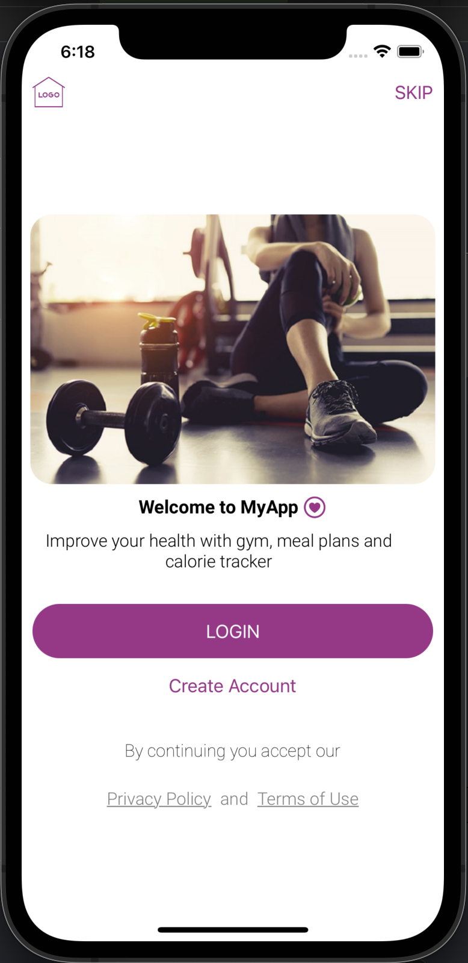
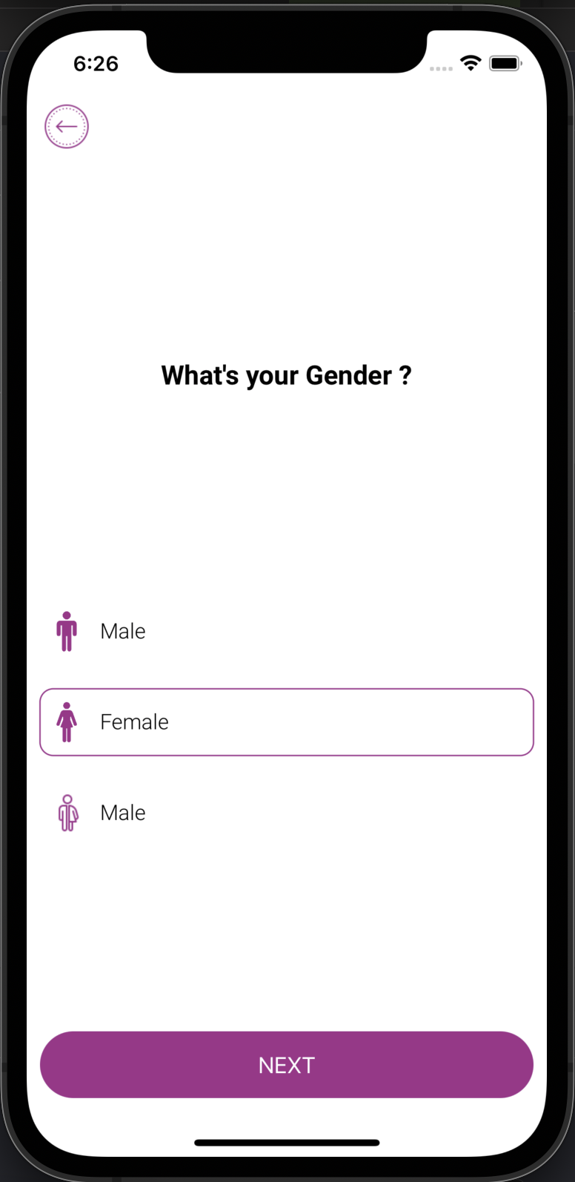
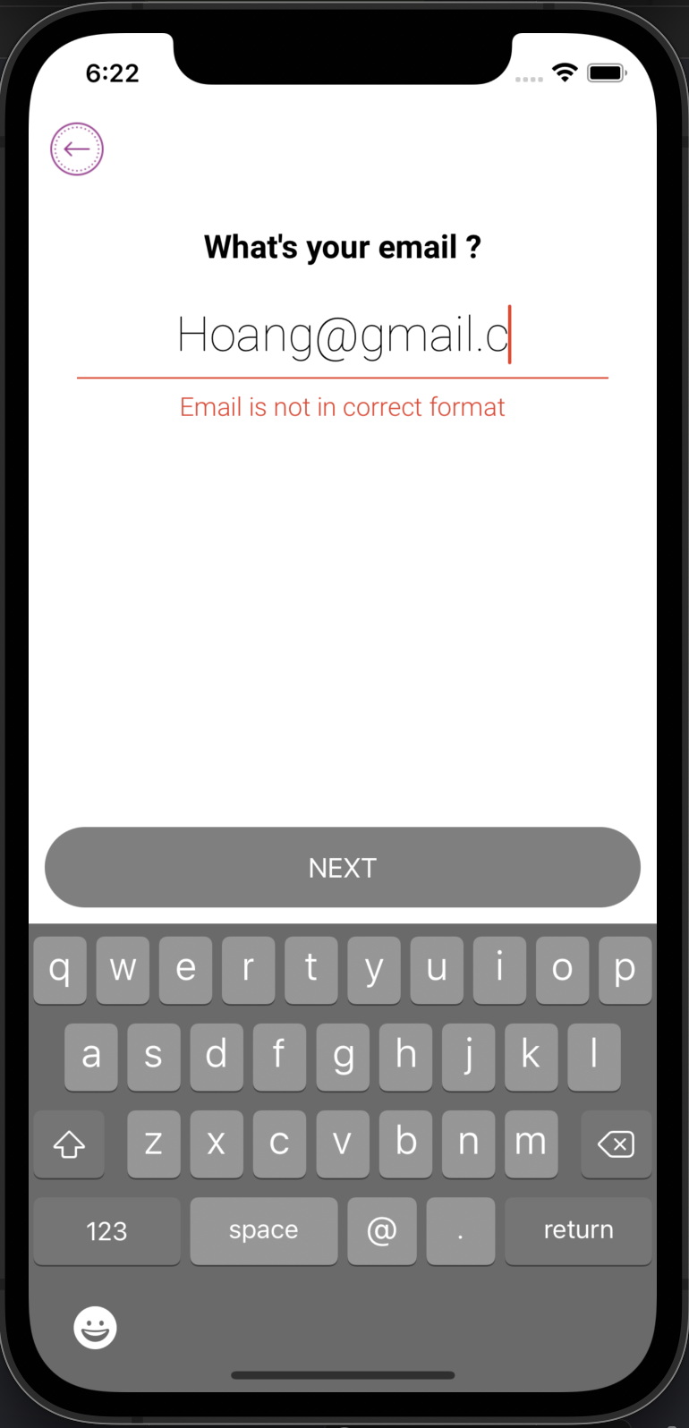
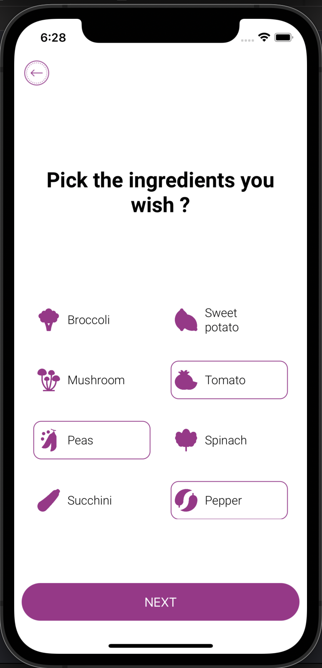
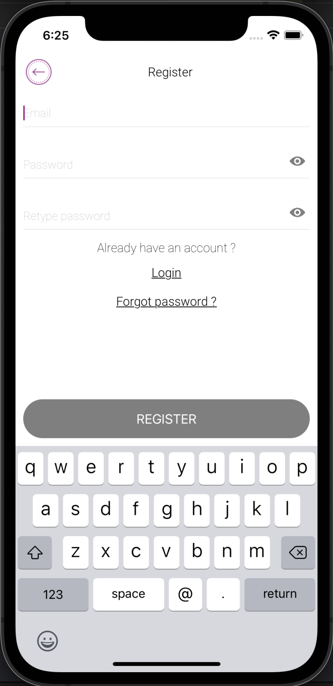
Navigate with Stack Navigation

Slide 3
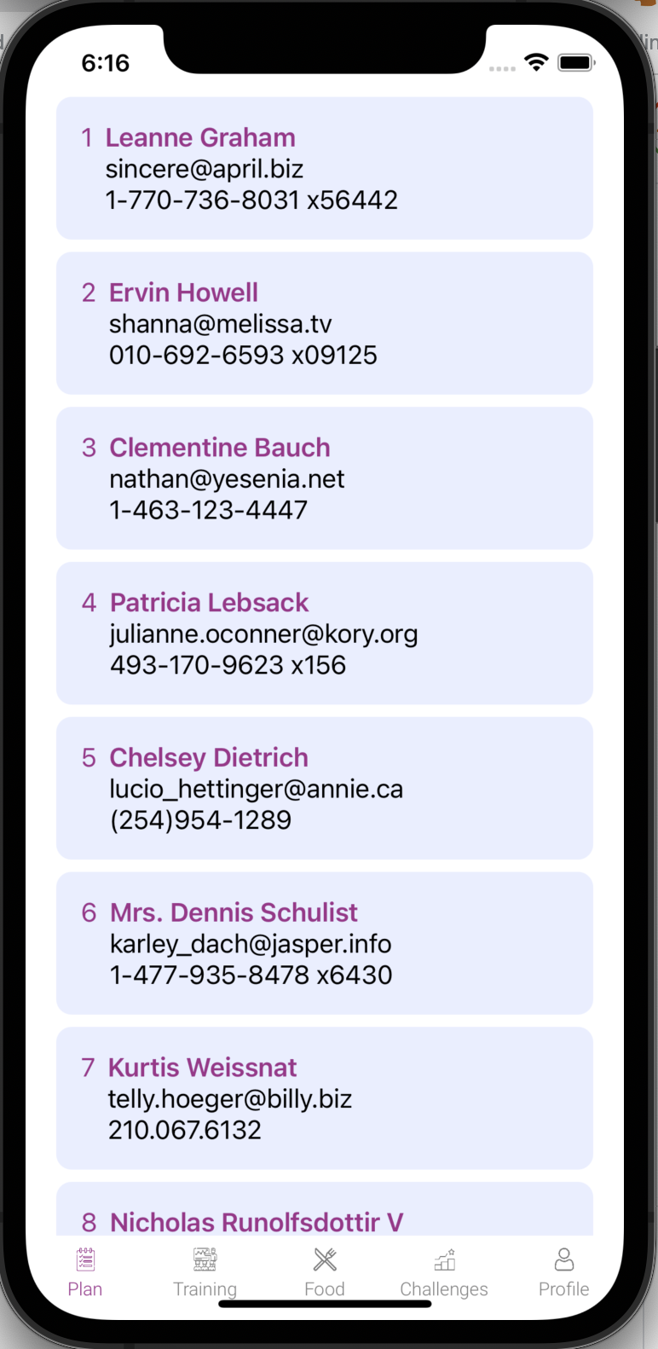
Navigate with Stack Navigation
NavigationLink(destination: Text("Second View")) {
Image("hws")
.renderingMode(.original)
}
//navigate to another screen
NavigationLink(destination: ResultView(choice: "Tails")) {
Text("Choose Tails")
}

Slide 4
Tab using ScrollViewReader
Write a Screen using Customized Tab:
- Each bottom Tab Bar icon has selected color
- Swipe left/right to navigate between tabs
- Change colors of active/inactive bottom items
- Navigate between Tab and other screens

Slide 5
Configure Tab Component
- A list of objects contain Tab’s icon and title
- Each screen on the Tab is a TabView
- selectedTab is state and change when user switch to new Tab
struct Tab {
var icon: Image
var title: String
}
let tabs: [Tab] = [
Tab(icon: Image(Icons.plan), title: "Plan"),
Tab(icon: Image(Icons.training), title: "Training"),
Tab(icon: Image(Icons.food), title: "Food"),
Tab(icon: Image(Icons.challenges), title: "Challenges"),
Tab(icon: Image(Icons.profile), title: "Profile"),
]

Slide 6
Configure TabView(red region)
NavigationView {
GeometryReader { geometry in
VStack(spacing: 0) {
TabView(selection: $selectedTab,
content: {
Plan().tag(0)
Training().tag(1)
Food().tag(2)
Challenges().tag(3)
Profile().tag(4)
})
.tabViewStyle(PageTabViewStyle(indexDisplayMode: .never))
Tabs(tabs: tabs, geoWidth: geometry.size.width, selectedTab: $selectedTab)
}
.foregroundColor(Colors.primary)
.ignoresSafeArea()
}
}.navigationBarHidden(true)

Slide 7
Configure Icon list
ScrollView(.horizontal) {
ScrollViewReader { proxy in
HStack(spacing: 0) {
ForEach(0 ..< tabs.count, id: \.self) { row in
let isSelected = row == selectedTab
Button(action: {
withAnimation {
selectedTab = row
}
}, label: {
//Icons and title here
})
}
}
.onChange(of: selectedTab) { target in
print("haha")
withAnimation {
proxy.scrollTo(target)
}
}
}
}
.frame(height: 55)

Slide 8
Detail icons and titles
VStack(alignment: .center, spacing: 0) {
// Image
tabs[row].icon
.renderingMode(.template)
.resizable()
.aspectRatio(contentMode: .fit)
.frame(height: 15)
.foregroundColor(isSelected ? Colors.primary : Colors.inactive)
Text(tabs[row].title)
.font(Font.custom("Roboto-Light", size: 12))
.foregroundColor(isSelected ? Colors.primary : Colors.inactive)
.padding(.vertical, 5)
}.frame(width: geoWidth / CGFloat(tabs.count), height: 52)
// Call this component:
Tabs(tabs: tabs, geoWidth: geometry.size.width, selectedTab: $selectedTab)

Slide 9
ASP.Net 5.0 Web Api
- Create Login/Register API with ASP. Net(5.0) Web API
- After login, server send back JWT Access Token & Refresh Token to client
- Database is SQLite or SQL Server(using Docker)
- Client use the response JWT Token to send other APIs
- Code is tested in .NET 5.0, Visual Studio 2019
- Let’s try to deploy it in MacOS’s Docker, create image with Dockerfile, setup multiple containers using Docker Composer…

Slide 10
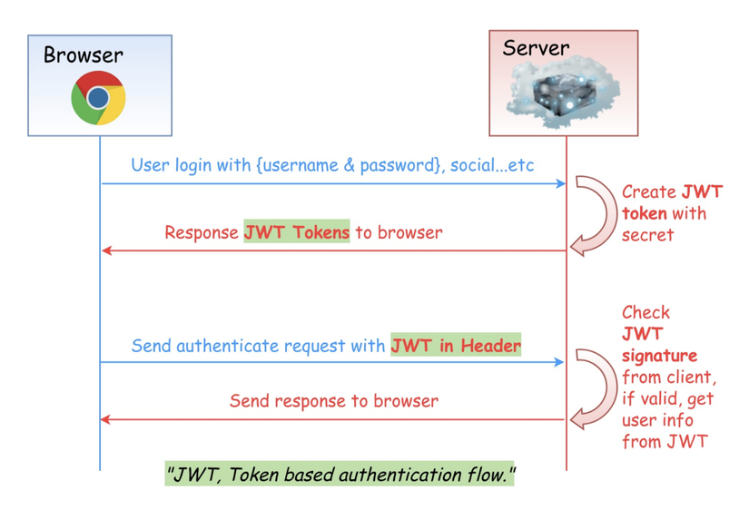
ASP.Net 5.0 Web Api
- Demo WebApi here is TodoListApp
- Data send/receive between Client-Server are DTO(Data Transfer Object)
- User can use multiple tokens to access Data(all tokens must be “not-expired”)

Slide 11
Send GET request with URLSession
- Client can use URLSession, Alamofire to send GET/POST/PUT/Delete request to Server
- Response data is saved to a component’s state(state can be an object/array of objects)
func getUsers(completion: @escaping (Result<[User], Error>) -> ()){
guard let response = response as? HTTPURLResponse else {
completion(.failure("why failed")
self.isLoading = false
return
}
if response.statusCode == 200 {
completion(.failure("response object")
self.isLoading = false
return
}
DispatchQueue.main.async {
//gest response object
}
}

Slide 12
Result object as response
- Response object is saved to Result, the response is loaded from a Callback function
guard let url = URL(string: urlGetUsers()) else {
completion(.failure(UserException.responseError(errorCode: ErrorCode.invalidUrl, message: "Invalid url")))
self.isLoading = false
return
}
let dataTask = URLSession.shared.dataTask(with: urlRequest) { (data, response, error) in {
if let error = error {
print("Request error: ", error)
self.isLoading = false
completion(.failure(UserException.responseError(errorCode: ErrorCode.internalServerError, message:error.localizedDescription)))
return
}
}

Slide 13
UI thread on Main Queue
The response object in the callback function is load to UI using Main Thread
guard let data = data else {
completion(.failure(UserException.responseError(
errorCode: ErrorCode.notFound,
message:error?.localizedDescription ?? "")))
self.isLoading = false
return
}
DispatchQueue.main.async {
do {
let decodedUsers = try JSONDecoder().decode([User].self, from: data)
self.users = decodedUsers
completion(.success(decodedUsers))
self.isLoading = false
} catch let error {
completion(.failure(UserException.responseError(errorCode: ErrorCode.internalServerError, message:error.localizedDescription)))
self.isLoading = false
}
}

Slide 14
Free Api for testing
These apis are for testing-purpose only:
- https://jsonplaceholder.typicode.com
- https://jsonbin.io/api-reference
- https://rapidapi.com/
in actual project, you need to develop your Api using:
-.NET Core Api,
- NodeJS & Express,
- Java Spring,
…and deploy with Docker/Kubenetes,…

Slide 15
ListScreen with Observable, Published
Fetch a List by calling API:
- Know about Global State management with Environment Object
- Understanding of Published, Observable, Environment Object
- Get response data and reload UI of more than 1 components

Slide 16
Repository
Repositories contain some functions to get Data from API, save it to some Environment Objects
class UserRepository:ObservableObject {
//Global objects/ Shared state
@Published var users: [User] = []
@Published var isLoading:Bool = false
func urlGetUsers() -> String {
"\(SERVER_NAME)/users"
}
func getUsers(completion: @escaping (Result<[User], Error>) -> ()){
//some code to get data from API
}
}
//response data is save to Global State
let decodedUsers = try JSONDecoder().decode([User].self, from: data)
self.users = decodedUsers
completion(.success(decodedUsers))
self.isLoading = false

Slide 17
Action / event
When the Screen loaded, user press “Login”, “Register” buttons, we call the function inside the repositories
.onAppear {
userRepository.getUsers { result in
}
}
//In screen’s UI
@EnvironmentObject var userRepository: UserRepository
if(userRepository.isLoading == true) {
//show progress bar
} else {
ForEach(userRepository.users) { user in
HStack(alignment:.top) {
Text("\(user.id)")
//Detail UI
Spacer()
}
.frame(maxWidth: .infinity)
}
}

Slide 18
Which screen listen to the Global object
SwiftUI gives us the @EnvironmentObject property wrapper. This lets us share model data anywhere it’s needed, while also ensuring that our views automatically stay updated when that data changes.
Plan().environmentObject(UserRepository())
//inside the screen
@EnvironmentObject var userRepository: UserRepository
//You can also test separated screens by calling:
struct Plan_Previews: PreviewProvider {
static var previews: some View {
Plan()
.environmentObject(UserRepository())
}
}
//Enable localhost Server in Info.plist
<key>NSAppTransportSecurity</key>
<dict>
<key>NSAllowsLocalNetworking</key>
<true/>
</dict>

Slide 19


